Slide 1
Explanation of logistic regression cost function (optional)
Coursera Deep Learning Specialization

Slide 2
Explanation of logistic regression cost function
We selected a cost function in logistic regression, here we shall discuss why did we do that.

Slide 3
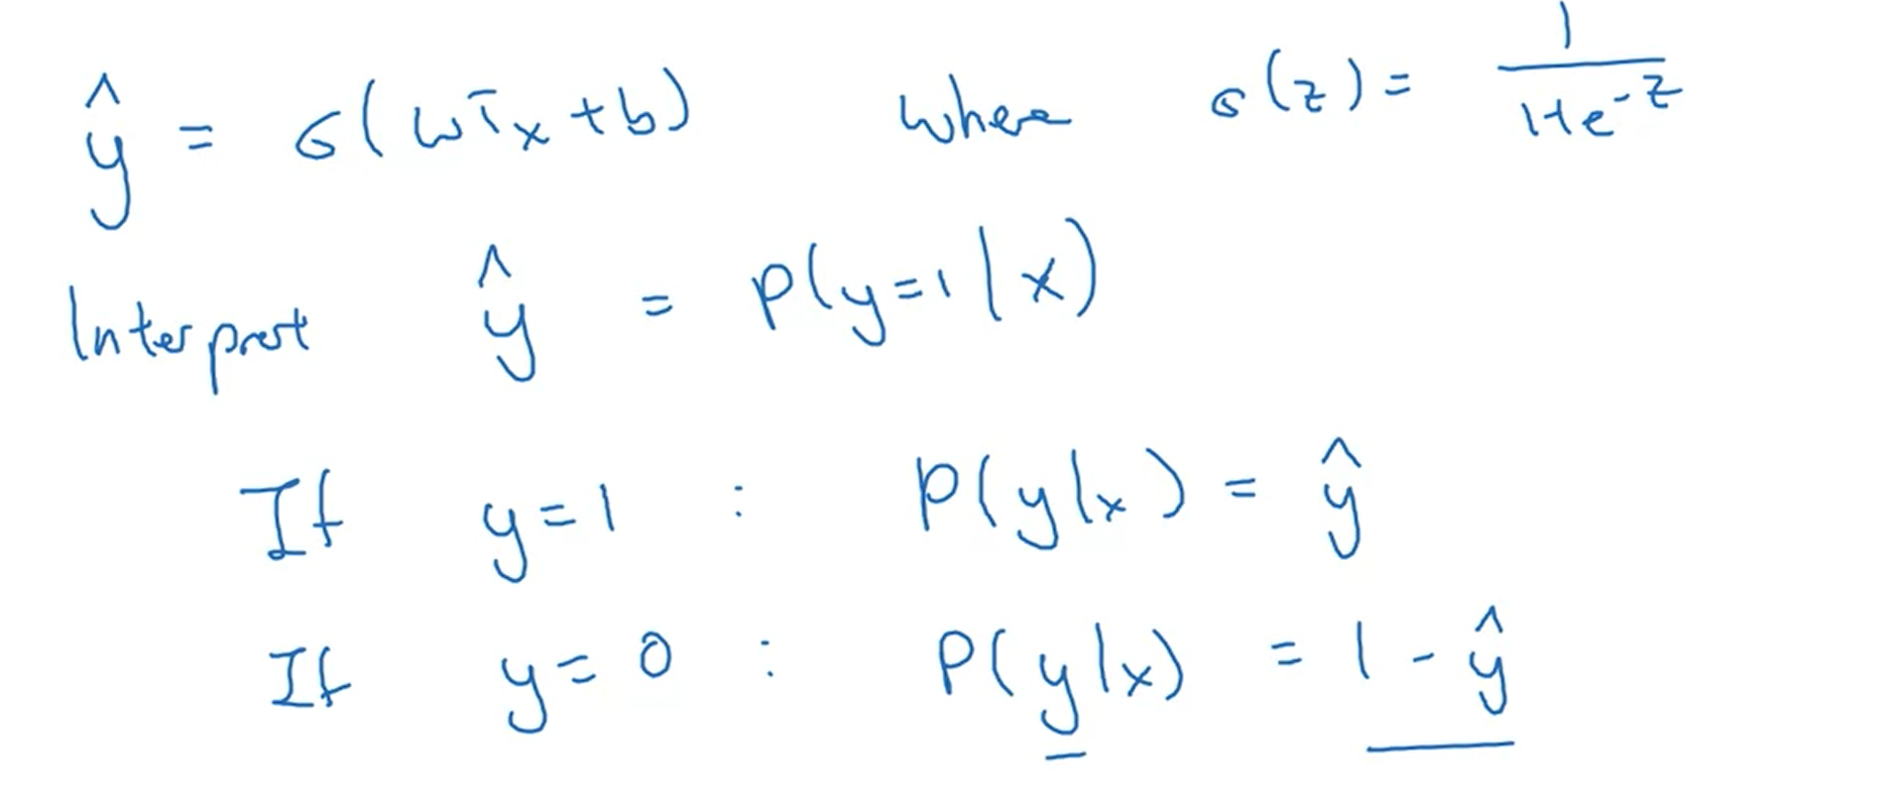
Cost Function 1
We interpret y hat
as a probability

Slide 4
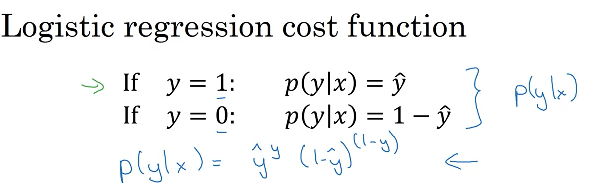
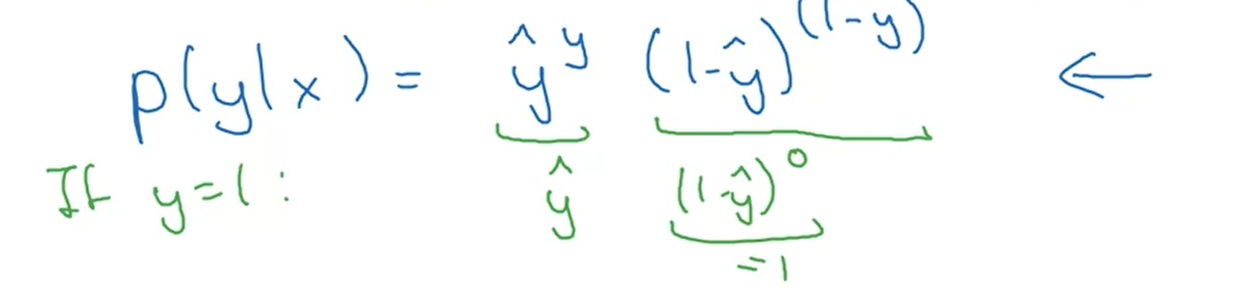
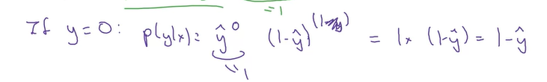
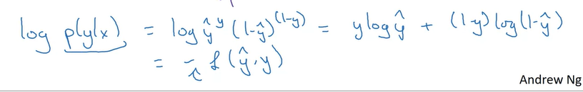
Cost Function Form
We have 2 cases for y values. Y can be either 0 or 1 since we are doing binary classification.
Now we will summarize the two equations in another form as shown.
Now this new form satisfies both the cases.
We have shown that the new form is the correct definition.
Now log function is a strictly monotonic function & we are maximizing, therefore if we take log of P(y|x) than it is similar to maximizing the probability.
This new form is equivalent to the –ve loss function.
In training a learning algo we want the prob large means minimizing the loss therefore we use negative sign

Slide 5
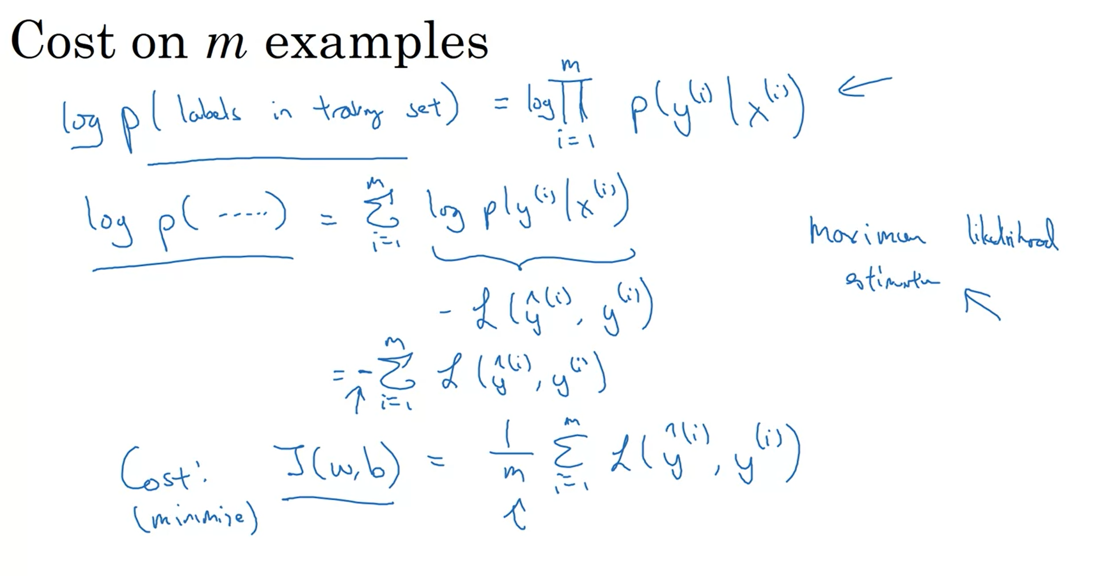
Cost Function form on m examples
If we assume that all the training examples are drawn independently, than the probability of examples is the product of all the probabilities.
Now we want to maximize the likelihood of these observations, now maximizing the prob of observation is same as the maximizing the log of this probability. Therefore we take the log on both sides.
Once we do that, we get the form In our loss function form.
In statistics principle, MLE will mean in this case is to choose the parameters such that the likelihood of these observations maximizes.
This justifies the cost for logistic regression we have. Since to maximize the likelihood we need to minimize the cost therefore we get rid of the negative sign.
At the end, we normalize it by dividing it over m.
As summary, to maximize the likelihood estimation we are minimizing the cost.

